Slide 1









ONLINE SAFETY IN SOCIAL MEDIA
Wang Tingyu Kelly, Duangporn Sirikulwattananon, Jessica Widyawati, Eu Shae-Anne, Tiffany Irene Prasetio
DSA4264 Project Presentation

Slide 2

01
Introduction
02
Overview of Project Workflow
TABLE OF CONTENTS
03
Natural Language Processing (NLP) Methodology
04
Large Language Model (LLM) Methodology
05
Key Insights and Recommmendations
06
Frontend Demo and Conclusion

Slide 3

CONTEXT
Growing trend of polarising and extreme content on social media, with a rise in harmful content perceived by users (66% in the latest poll, up from 57% the previous year)
Increases in unsafe content online poses a threat to public safety
AIM
Develop quantitative frameworks to assess levels of online toxicity and hate, specifically within Singapore subreddits
Identify key drivers of online toxicity and hate
Provide useful insights and actionable recommendations for the MDDI Online Trust and Safety department

Slide 4



DEFINITIONS
What is a key topic?
What is toxic and hateful?
Toxic
Content that is rude, disrespectful, or profane, including the use of slurs
Hateful
Content that expresses, incites, or promotes hate based on race, gender, ethnicity, religion, nationality, sexual orientation, disability status, or caste.
Specific and In-depth
To allow for targeted analysis and provision of practical recommendations
Representative
To account for a substantive proportion of all comments in the dataset

Slide 5
CAVEATS
DATA SUFFICIENCY
COMPUTATIONAL RESOURCES
The dataset provided is complete and sufficiently broad enough capture representative trends.
Given computational constraints, we were limited in our ability to conduct extensive tuning on the entire dataset and all hyperparameters.

Slide 6
OUR WORKFLOW
NLP Stage
LLM Stage
Recommendations
Identify key topics in the comments using Topic Modelling methods
Label toxic comments within key topics using Large Language Models
Identify and assess levels of toxicity and hate over time
Deep dive into 3 key topics: Politics, Religion and Transport

Slide 7
NLP METHODOLOGY
AIM: IDENTIFY THE MOST ‘TALKED ABOUT’ TOPICS

Slide 8

DATA
Data Collection
Reddit comments from 2020-2023 from 3 subreddits
r/Singapore, r/SingaporeRaw, r/singaporehappenings
Metadata includes timestamp, subreddit sources, text (comments)
Data Quality
Unstructured Reddit dataset with slang, emoji, informal language, and mix of languages
Challenges with inconsistent formatting
Data Cleaning
Stopword Removal: Contextual stopwords (Singaporean slang)
Chinese Character Removal: Focused on English content
Punctuation & Special Characters: Retained symbols when contributing to sentiment
Short Comments: Removed comments <8 words to enhance dataset quality

Slide 9
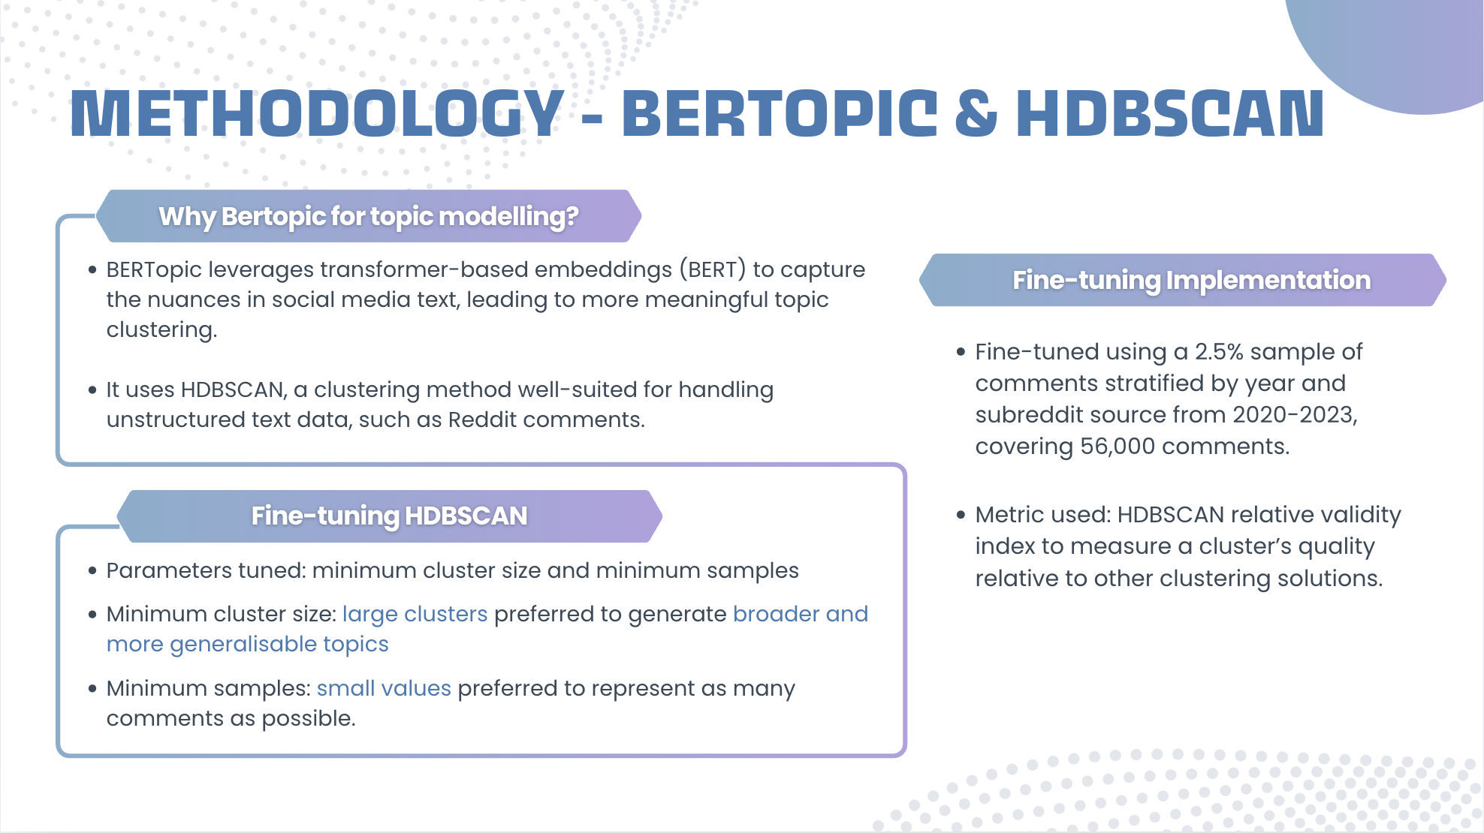

Slide 10
METHODOLOGY - TOPIC MODELLING
Step 1: Pre-generate text embeddings
Step 2: Topic Modelling
Pre-generated text embeddings by year to optimise runtime and circumvent computational constraints (limited GPU and RAM accessibility)
Run topic modelling using the bertopic model initiated with optimal parameters from HDBSCAN, by year, on the pre-generated text embeddings
Step 4: Filtering for Major Topics
Step 3: Tagging topics to comments
Filter the dataset to retain comments tagged to the top 15 topics
Topics generated: ranked in the order of importance (most frequently appearing)
Extract the topics generated from each year, and tag each comment from the yearly dataset to the corresponding topic

Slide 11
NLP TECHNICAL ASSUMPTIONS
FINE-TUNING HDBSCAN
FINAL NUMBER OF TOPICS CHOSEN
Default parameter options are considered optimal (except for minimum cluster size and minimum samples)
For each year, we identified the top 15 topics, out of a list of around 200-250. These top 15 topics represented about 7-10% of the dataset

Slide 12
LLM METHODOLOGY

Slide 13
LLM METHODOLOGY OVERVIEW
Experimental models
Rule-based approach
Manual labelling
Model selection

Slide 14
LLM METHODOLOGY
Pre-trained LLM model
+
Rule-based approach
Experimental models
Vader
Perspective API
Bert
Singlish toxic dictionary
Toxic comments in Singlish may not be detected
Created a dictionary with a curated list of common toxic words in Singlish
Immediately flagged as toxic if a comment contains word in the dictionary

Slide 15


WHICH LLM SHOULD WE CHOOSE?
Vader
Perspective API
Bert
Manual labelling
LLM labelling
Randomly sampled 200 comments
Manually label according to our toxicity definition
Label again using pre-trained LLMs with rule-based approach on different thresholds
Model selection
Calculate Metric
Vader scores based on sentiment
Perspective has the highest recall but computationally expensive
Unitary/toxic-bert was the next best, with threshold = 0.1
Recall as primary metric
Preferable to classify a non-toxic comment as toxic than mislabelling a toxic comment
Final model

Slide 16
LLM TECHNICAL ASSUMPTION
DATA PREPROCESSING
The toxicity trend of comments with less than 8 words would not differ significantly with our current data selection
COMPARISON ACROSS TIME
Variations in sub-topics selected across time would not introduce significant bias and alter the overarching toxicity trend
SAMPLING METHODOLOGY
Sampled data for manual labelling is representative and contains a substantial amount of toxic comments

Slide 17
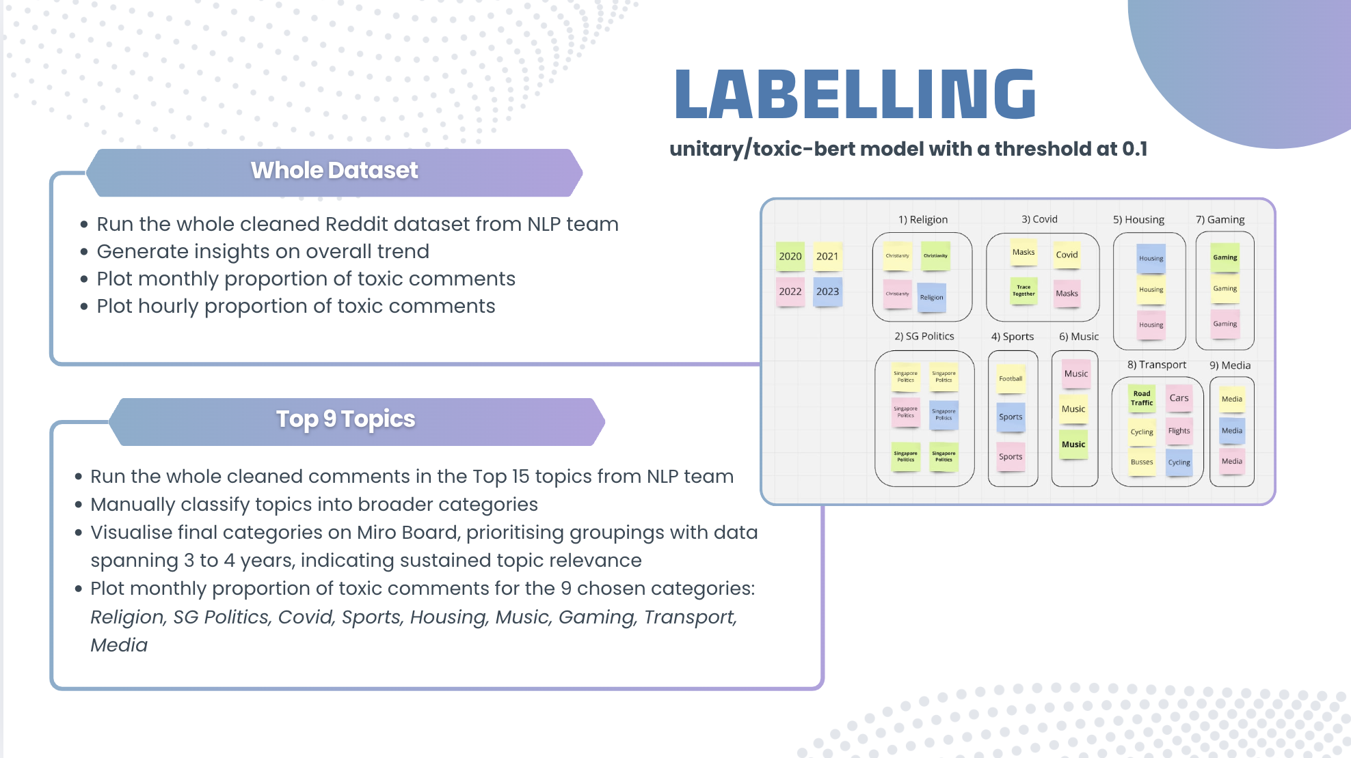

Slide 18
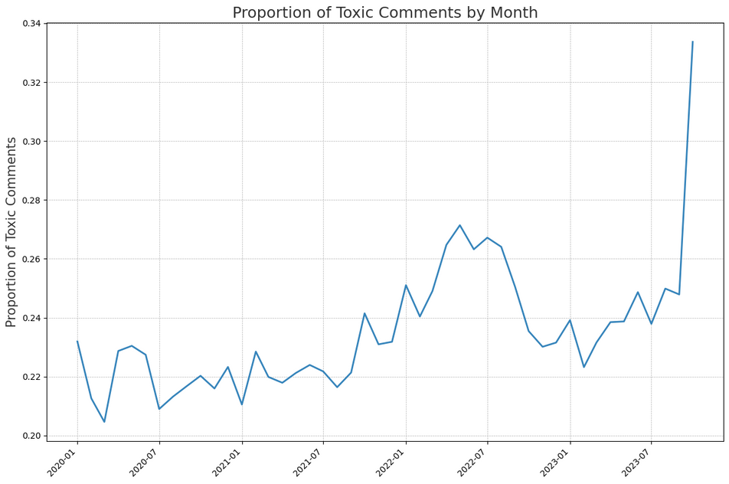
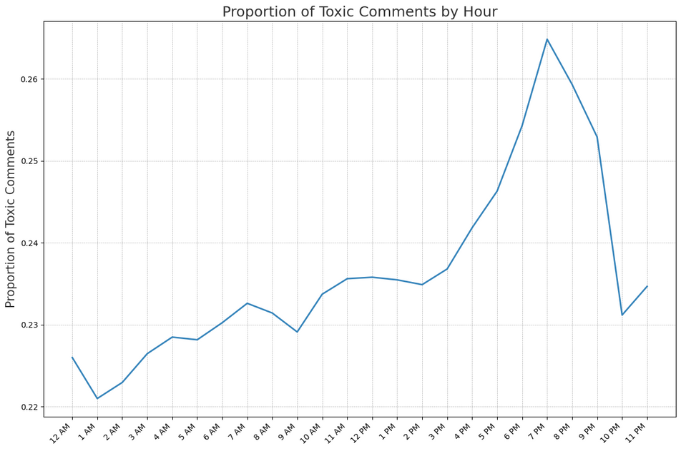

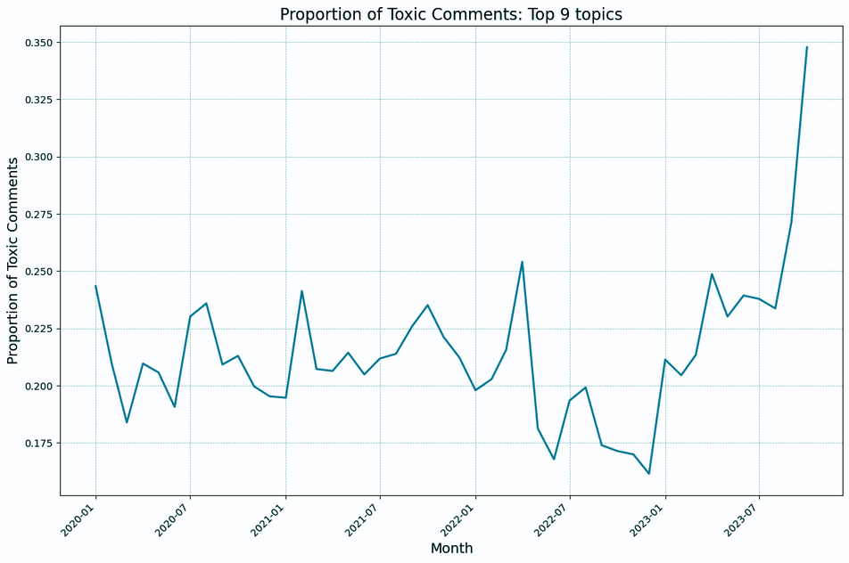
GRAPHICAL ANALYSIS
Monthly Trend
Hourly Trend

Slide 19
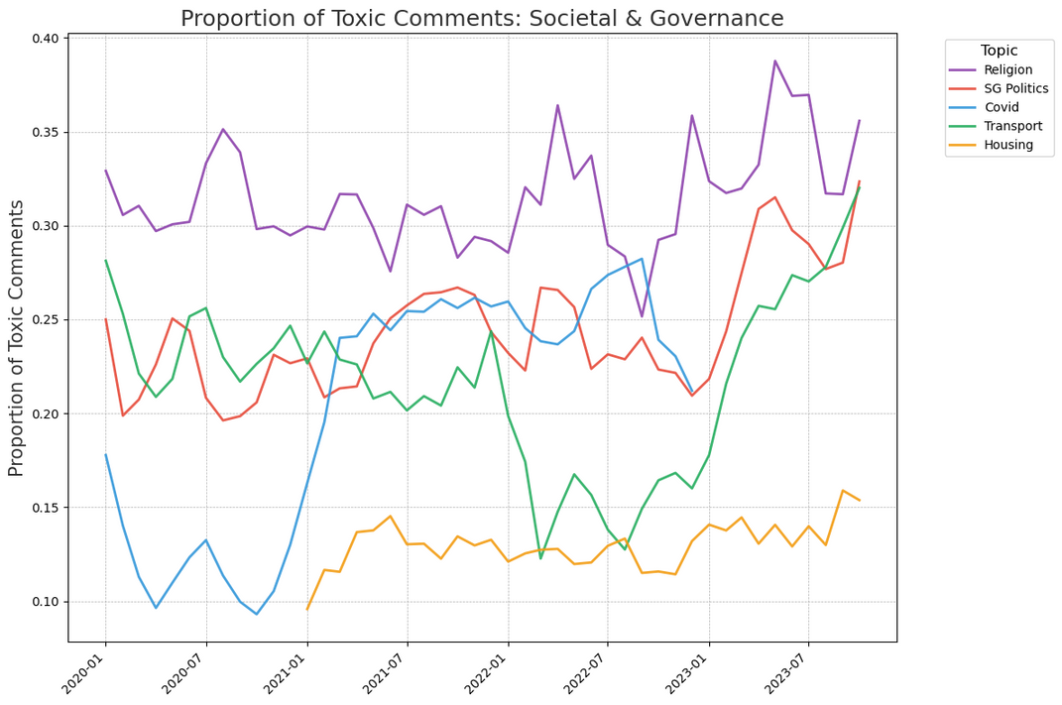
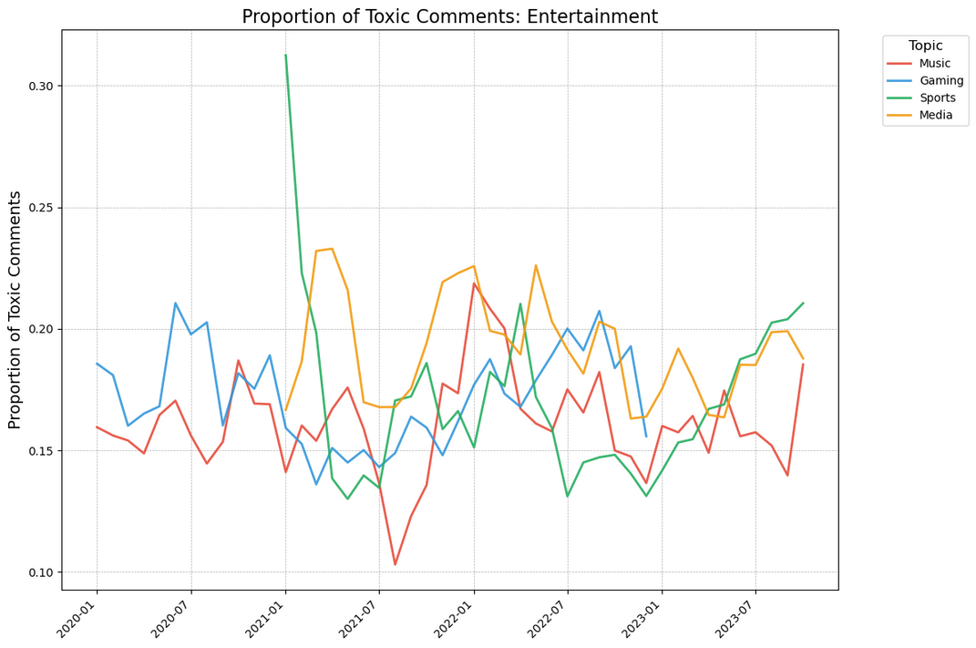
GRAPHICAL ANALYSIS
Societal and Governance
Entertainment
TOPICS FOR ANALYSIS: SG POLITICS, RELIGION, AND TRANSPORT

Slide 20
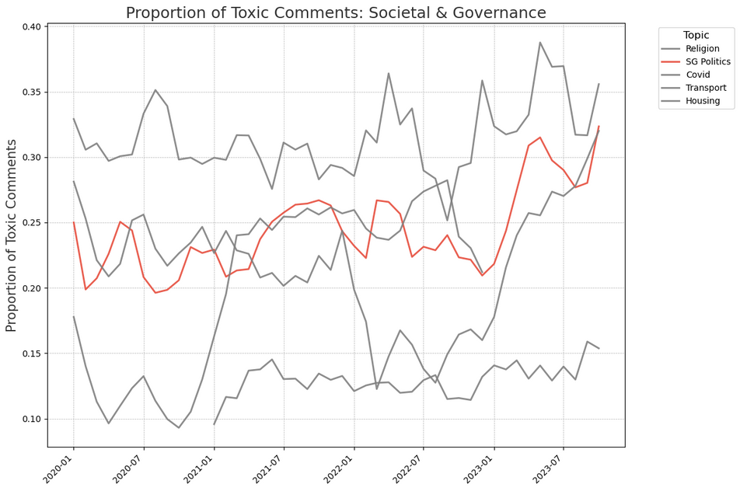
SG-POLITICS
Notable peak in second half of 2021
Lying incident involving Workers’ Party MP Raeesah Khan
Critical discussion on WP’s party credibility, political transparency and ethical standards
Notable peak in early 2023
High-profile extramarital affairs among political figure
Ridout Road property rental controversy
Increase public skepticism and criticism toward both ruling and opposition parties.
General Increase and spikes
Moderate variability
Moderate level of toxic commentary
On the rise over the recent year
General disgruntlement toward the PAP alleged gerrymandering practices and ineffective policies following 2020 general election’s result

Slide 21
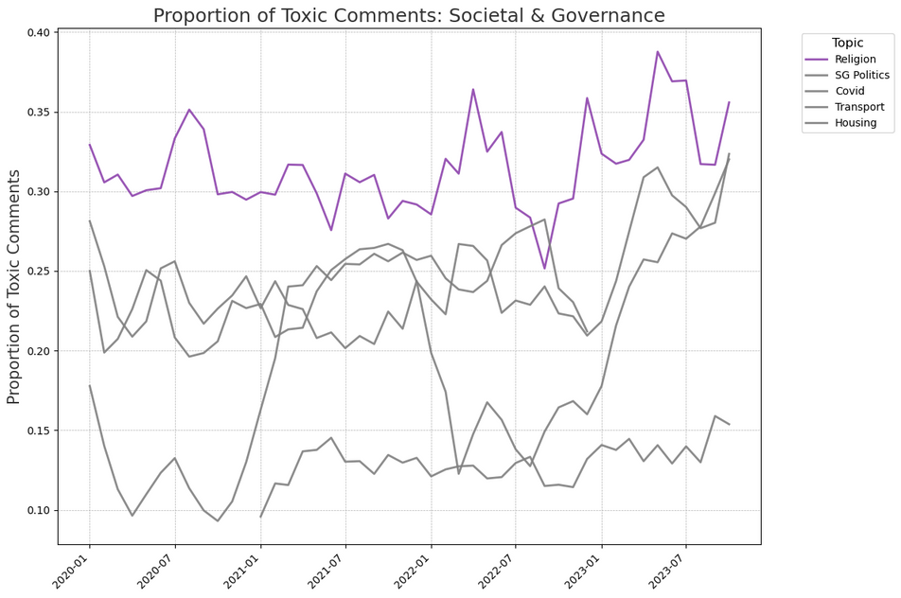
RELIGION
Notable peak in second half of 2020
Controversies around Pastor Pauline Ong at the Free Community Church (FCC) and Pastor Miak Siew, the first ordained openly gay minister in the country
Notable peaks in early 2023
Debates following the repeal of Section 377A in January
The Ministry of Home Affairs’ emphasis on religious harmony in March 2023 also fueled conversations
General Increase and spikes
High variability
High level of toxic commentary
On the rise over the recent year
Discourse on Christianity, Islam, and their practices
Debates between atheists and non-atheists
Christian perspectives on LGBTQ+ issues

Slide 22
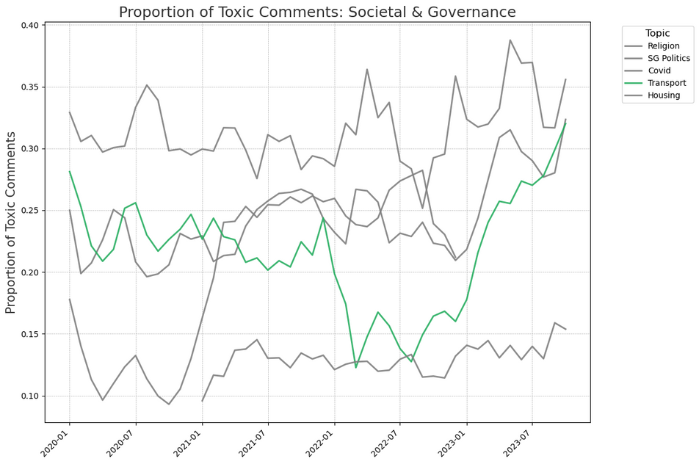
TRANSPORT
Initial Peak in 2020
Road accidents (pedestrains, motocyclist, cyclists, cars)
Road safety and reckless driving
A controversial six-month car ban petition
Notable Drop in late 2021 into mid-2022
Counterintuitive due to a slight increase in traffic accidents (SPF’s Annual Road Traffic Situation 2022)
A shift in public focus toward other social issues?
Upward Trend from mid-2022 into late 2023
Significant variability
Moderate level of toxic commentary
On the rise over the recent year
Align with increase in fatal and non-fatal traffic accidents (SPF’s Annual Road Traffic Situation 2023)
Tension among road users

Slide 23


RECOMMENDATION
Social Media Platforms
Enhanced Content Moderation
Peak Time Moderation
Apply stricter moderation protocols for the identified topics: Religion, Singapore Politics, Transport, Sports, Music
Automated and manual review processes to address harmful content promptly while safeguarding free expression
Allocate additional resources between 6pm and 10pm where toxicity peaks
Hey Redditor, please follow community’s guidelines on language use :)

Slide 24



RECOMMENDATION
Governmental Issues
Religion
SG Politics
Incorporate religious education in school curriculum
Religious Harmony Day
Community-led dialogues
Foster interfaith understanding
Offer safe spaces for discussing differences and promoting tolerance
Policies to strengthen transparency and accountability in politics
Clearer guidelines for handling conflicts of interest such as bribe cases
Enhance public communication
Transportation
Enforce stricter traffic rules
Curb the increasing number of traffic accidents
Public education on road safety
Act carefully given diverse needs of road users

Slide 25




NEXT STEP
Fine-tuning Model for Singlish Context
Broadening Topic Scope over >9
Automated Analysis of Comment using LLM
Experiment with other BERTopic components

Slide 26

Frontend Dashboard

Slide 27
Thank You!
Question Time!

